Slide 1
SOIL, WATER AND CROP QUALITY ASSESMENT ON A RECLAIMED DAMSITE AT ABOSSO GOLDFIELDS.
GYABAA EMMANUEL
AMEKLODZI BOBLIN
KISSIEDU LESLIE

Slide 2
Table of contents
Introduction
Problem Statement
Purpose and Specific Objectives
Study Area
Methodology
Results

Slide 3
Introduction
Tailings storage facilities are earth filled embankments used to store by-products of mining operations.
Concerns have been raised about the environmental performance of tailings storage facilities.
Leaching of toxic metals from the tailings dams increase the concentration of heavy metals at the earth surface.

Slide 4
Introduction
These heavy metals include Cd, Pb, As, Zn, Cr, Co and Ni.
The presence of heavy metals in food, water and soil pose serious problems to public health.
Pollution by heavy metals affects the productivity of crops cultivated on these lands.

Slide 5
Problem statement
The reclaimed damsites at Abosso may have a potential for agricultural activities. Release of heavy metals from mine tailings into the environment affects soil and water quality in these reclaimed areas. Food crops cultivated in these areas may assimilate these heavy metals in large quantities and this poses a serious health risk to both the plants and consumers.
Justification
This project will help create awareness about the geochemical state of the reclaimed damsites at Abosso Goldfields and to check if the area is suitable for agricultural purposes.

Slide 6
Purpose
The purpose of this project is to determine the level of contamination of soil and water by heavy metals and assess the health risk associated with the consumption of crops harvested from the reclaimed damsites at Abosso Goldfields.
Specific Objectives
To determine the heavy metal contents in soils and pockets of water bodies from the reclaimed damsite.
To determine the heavy metal contents in crops harvested from the reclaimed damsite.
To determine the heavy metal content in soils from a control site.
To evaluate the degree of heavy metal pollution of soil and water on the reclaimed damsite.
To assess the health risks posed by the consumption of crops harvested from these contaminated soils.

Slide 7
Study Area
Abosso can be found within the Ashanti belt.
The area is characterised by Tarkwaian sediments underlain by Birimian rocks.
Rock formations present include Huni Sandstone, Tarkwa phyllite, Argillite, Conglomerates, Dolerite, and Basalt.

Slide 8
Map of Study Area

Slide 9
Methodology
The methodology consists of the pre-field, post field and field work.
The pre-field work involves map preparations and finding relevant background information of the study area.
The field work consists of soil, water and crop sampling.
The post field work consists of sample preparation and laboratory analysis.

Slide 10
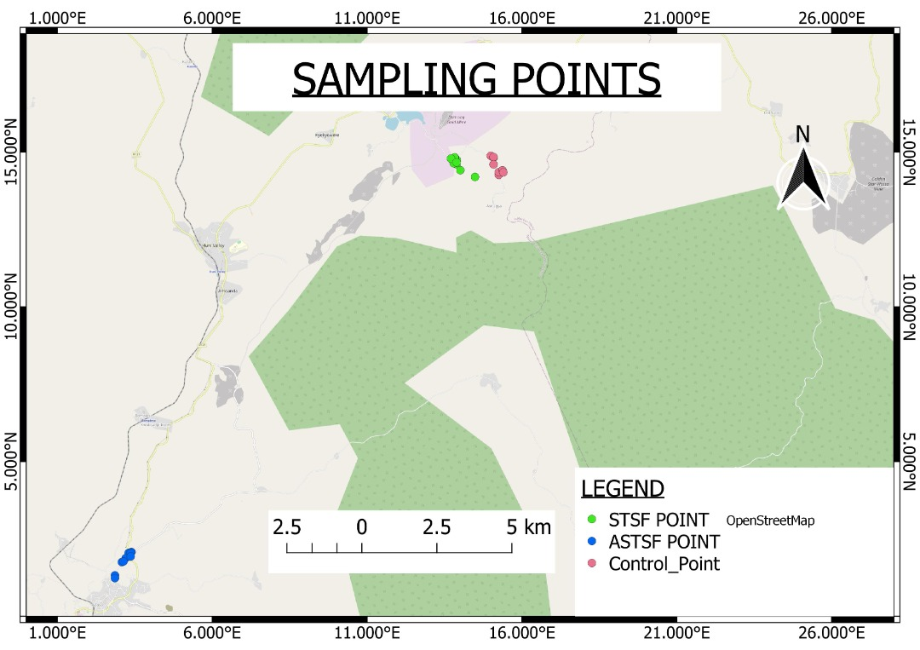
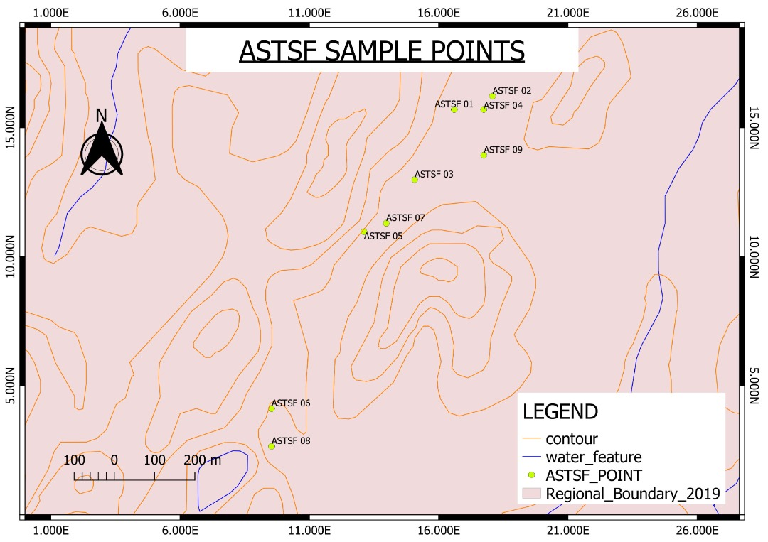
Methodology

Slide 11
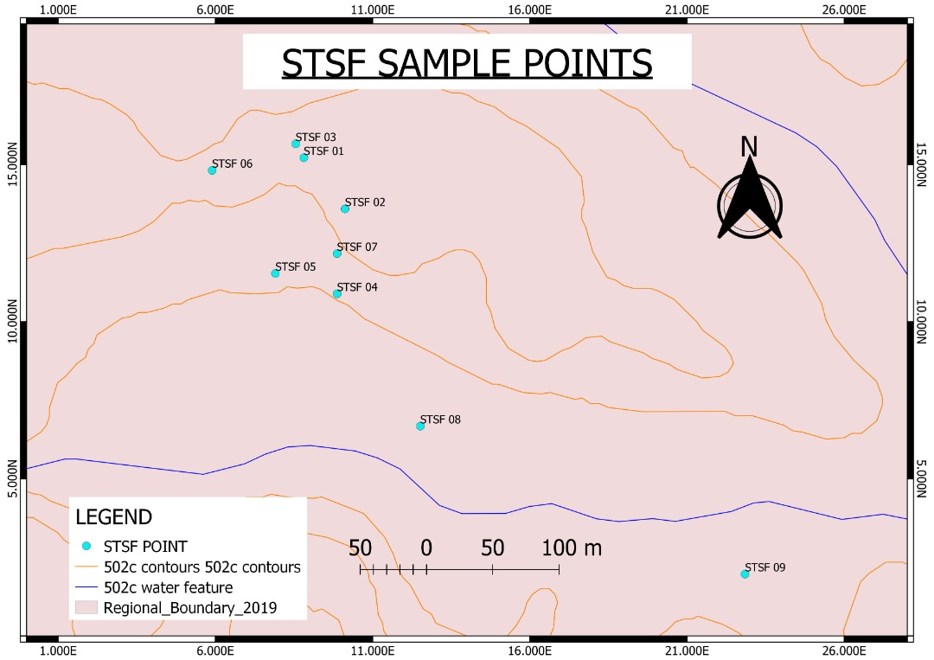
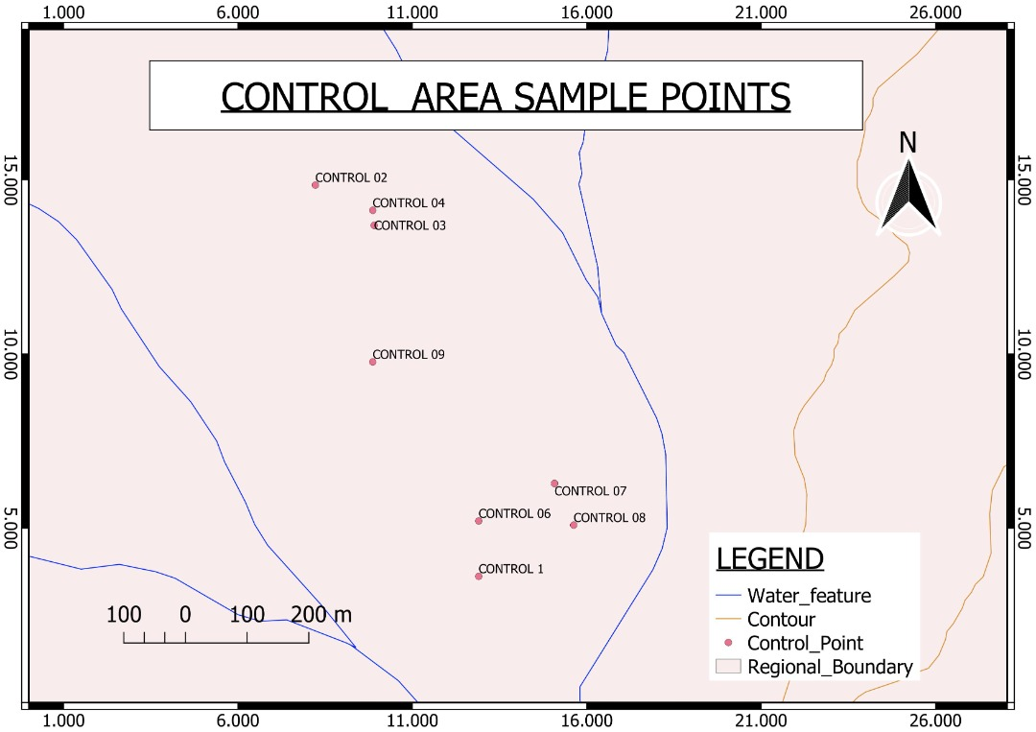
Methodology

Slide 12
4. RESULTS AND DISCUSSIONS
Trace element concentrations in the soils at the STSF.
Site | pH | Zn | Pb | As | Ni | Co | Cr
STSF
Min | 7.5 | 9.6 | 6.0 | 0.1 | 9.1 | 5.9 | 22.0
Max | 8.5 | 16.0 | 23.0 | 0.2 | 22.0 | 18.0 | 89.0
Mean | 8.2 | 11.2 | 10.5 | 0.1 | 18.5 | 11.0 | 52.5
Median | 8.4 | 10.7 | 10.0 | 0.1 | 20.0 | 11.0 | 49.0
SD | 0.3 | 2.0 | 5.1 | 0.0 | 4.1 | 3.2 | 17.9
Skewness | -1.3 | 1.6 | 1.8 | 0.2 | -1.4 | 0.8 | 0.5
ATSF
Min | 7.5 | 25.0 | 8.0 | 2.0 | 5.9 | 8.1 | 12.0
Max | 8.5 | 97.0 | 46.0 | 5.0 | 14.0 | 13.0 | 43.0
Mean | 8.2 | 66.9 | 32.0 | 3.6 | 9.7 | 11.4 | 26.6
Median | 8.2 | 68.0 | 32.0 | 3.7 | 9.3 | 12.0 | 26.8
SD | 0.3 | 21.4 | 10.9 | 1.0 | 2.3 | 1.7 | 9.0
Skewness | -1.2 | -0.8 | -1.3 | 0.0 | 0.5 | -1.1 | 0.1
CONTROL
Min | 6 | 3.1 | 2 | 0.2 | 0.05 | 0.03 | 3
Max | 6.5 | 6.1 | 5 | 1.8 | 0.45 | 0.27 | 5
Mean | 6.3 | 4.5 | 3.2 | <2 | <0.5 | <0.3 | 4.5
Median | 6.25 | 4.5 | 3 | <2 | <0.5 | <0.3 | 5

Slide 13
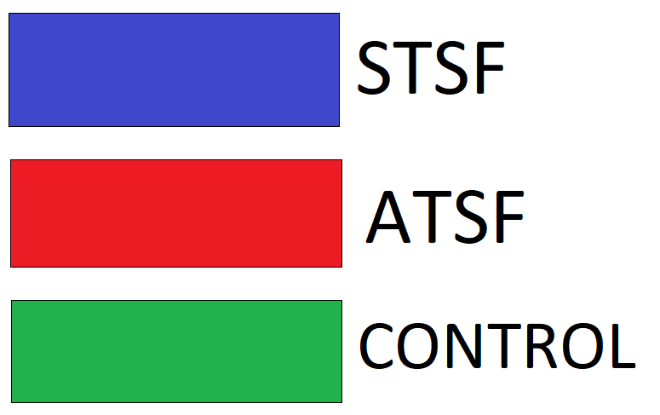
Results and discussions

Slide 14
RESULTS AND DISCUSSIONS.
Mean pH and trace element concentrations in the soils.

Slide 15
Thank you

